Slide 1
Automatic Coconut Breaking, Scraping, and Grinding Machine
IN 1900 (ICT Project)
Interim Presentation
Group No:15

Slide 2





Group Members
 | Name | Registration Number | Photo
Group leader | Nusky M.N.N. | 204146L
Member 1 | Banu A.G.S. | 204018X
Member 2 | Karunaweera R.L. | 204096G
Member 3 | Kumarasingha H.J.A. | 204108A
Member 4 | Lamahewage D.R. | 204114M

Slide 3
Outline
Problem in brief
Project Aim and Objectives
Proposed Solution
3D Diagram
3D Animation
Circuit Diagram
Resource Requirements
Cost Estimation
Testing and implementation

Slide 4
Problem in brief
Hard & risky to break the coconut using knife with our hand.
Difficult with scraping the coconut for a long time holding with the hands.
Taking time to cut, scrape and grind the coconut separately.
Have risk with handling the coconut through an unsafe machine.

Slide 5
Project Aim and Objectives
Aim
Design and develop an automated machine for process of coconut breaking, scraping & grinding with safety mechanism.
Objectives
To break the coconut and get the water separately.
To scrape the coconut.
To grind the coconut.
To maintain the process safely.

Slide 6
Proposed Solution
Inputs
Process
Outputs
Text and numbers
Display
Numbers
Analyze the user inputs and starting the coconut breaking process.
Sound
Keypad
Buzzer
Rotate the motor
DC motor
Rotating the cut disk and coconut scraper
Distance (Water level)
Analyze the water level of the water tank and send signals to the buzzer.
Ultrasonic sensor
Rotate the motor
Servo motor
Pointing the coconut fixing handle towards the coconut scraper
Detection (of the cut disk)
Starting the process of coconut scraping and grinding after analyzing the signal of IR sensor and send signals to Servomotor, DC motor and blender system.
IR sensor
Rotate the motor
Stepper motor
Moving the cut disk up and down.
Grinding
Blender system
Atmega 32 Microcontroller

Slide 7
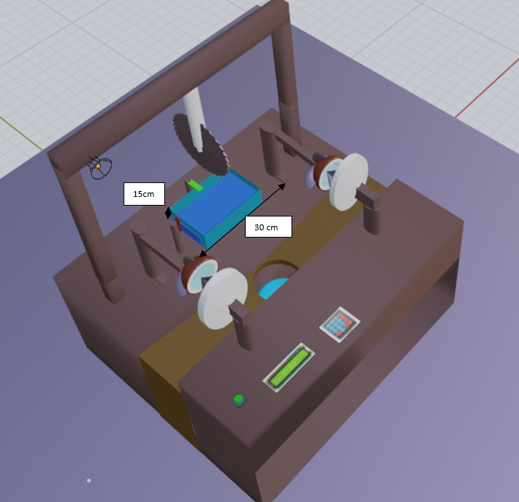
3D Diagram
Cut disk
(DC motor)
Coconut fixing handle
(Servo motor)
Actuator
(Stepper motor)
Coconut scraper
(DC motor)
Alarm
IR sensor
Ultrasonic sensor
Coconut water tank
Keypad
Push button
Display
Figure 1 -Overview

Slide 8
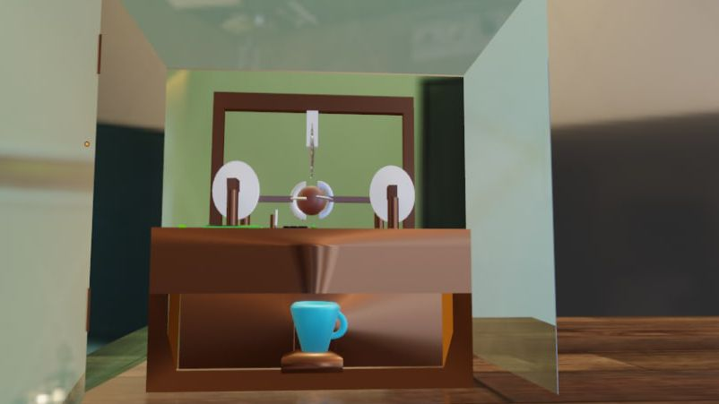
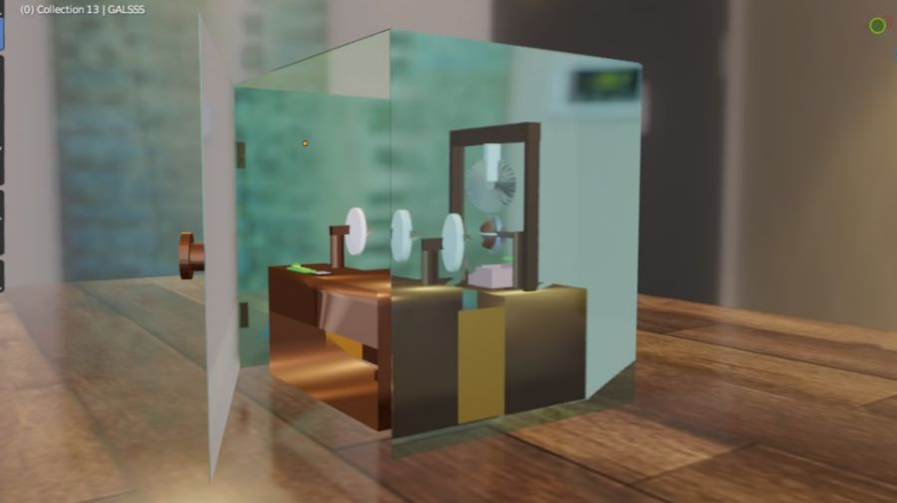
3D Diagram
Glass box
Blender
Figure 2 -Front view
Figure 3 –Right side view

Slide 9
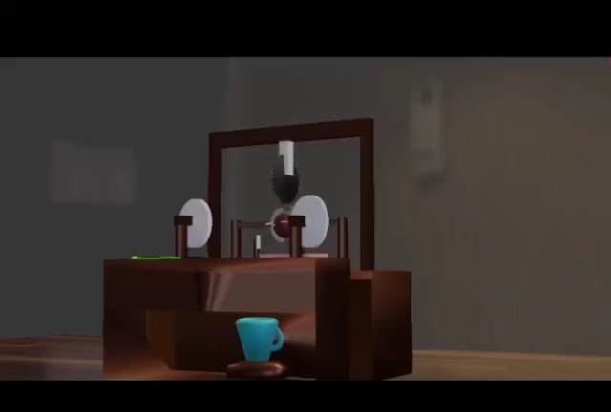
3D Animation
Link for 3D Animation: https://drive.google.com/file/d/1ILcT4oXj9GX8DXqPTRbnsRM1xtLKLiQE/view?usp=drivesdk

Slide 10
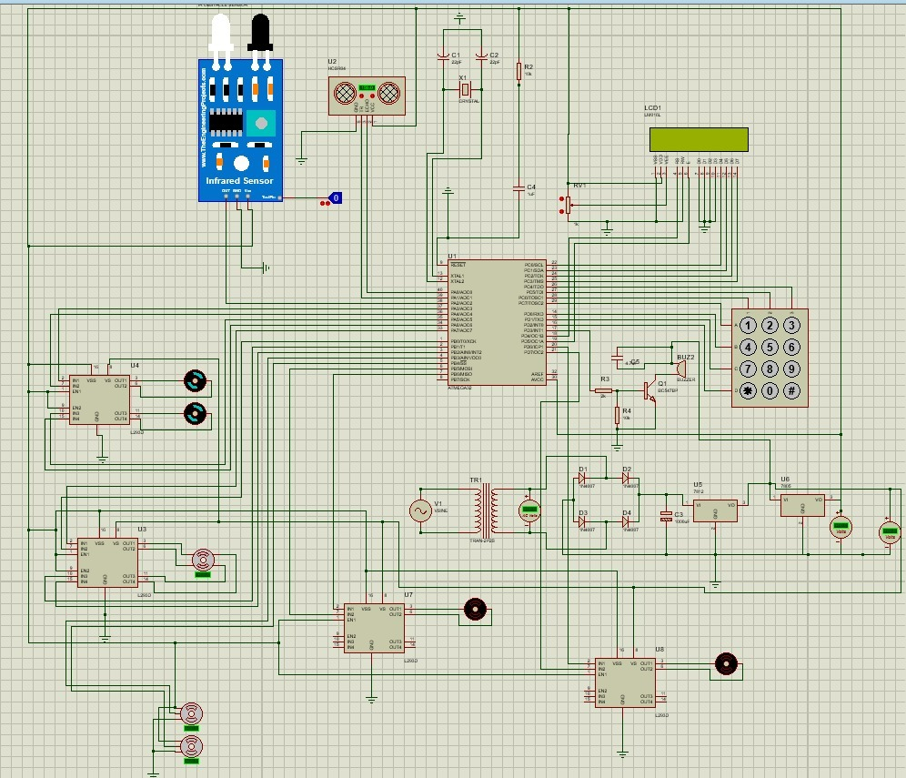
Circuit Diagram
Figure 4 –Circuit Diagram

Slide 11
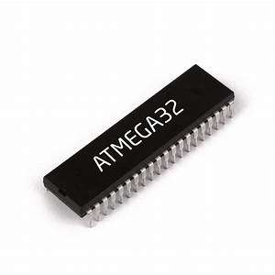

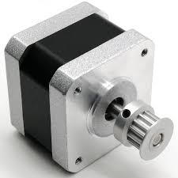
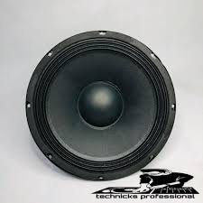
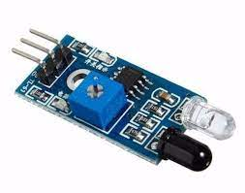
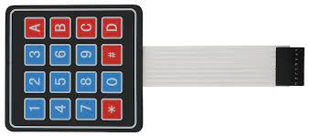
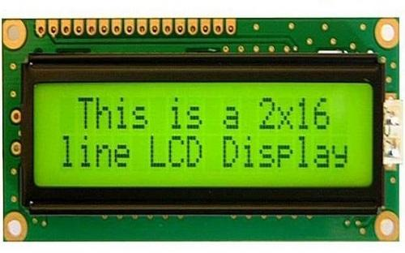
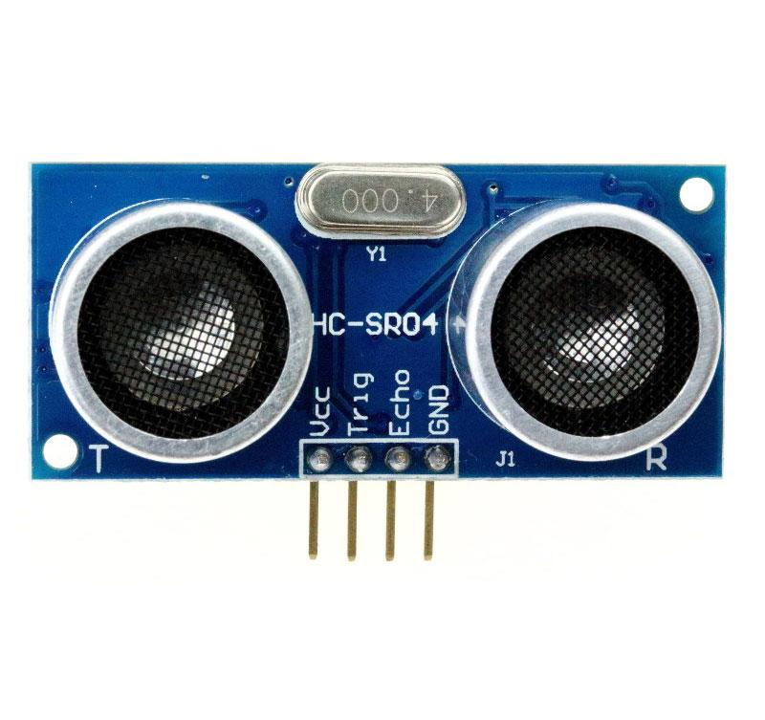
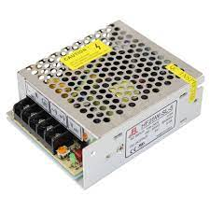
Resources Requirements
Software:
Atmel Studio
Simulation software
Blender software
Hardware:
Microcontroller: Atmega32
IR Sensor
Ultrasonic sensor
Keypad
Alarm
Display
Stepper motor
Servo motor
DC motor
Push button
Blender system

Slide 12
Cost Estimation
Item | Quantity | Price (Rs) | Subtotal (Rs)
Atmega32 | 1 | 540 | 540
IR sensor | 1 | 25 | 25
Ultrasonic sensor | 1 | 200 | 200
Alarm | 1 | 300 | 300
Keypad (3*3) | 1 | 160 | 160
Display (2*16) | 1 | 600 | 600
Push button | 1 | 10 | 10
Servo motor | 2 | 500 | 1000
Stepper motor | 2 | 1050 | 2100
DC motor | 3 | 1250 | 3750
Blender system | 1 | 3500 | 3500
Finishing | 1 | 4000 | 4000
Total |  |  | 16185
Figure 5 – Estimated cost

Slide 13
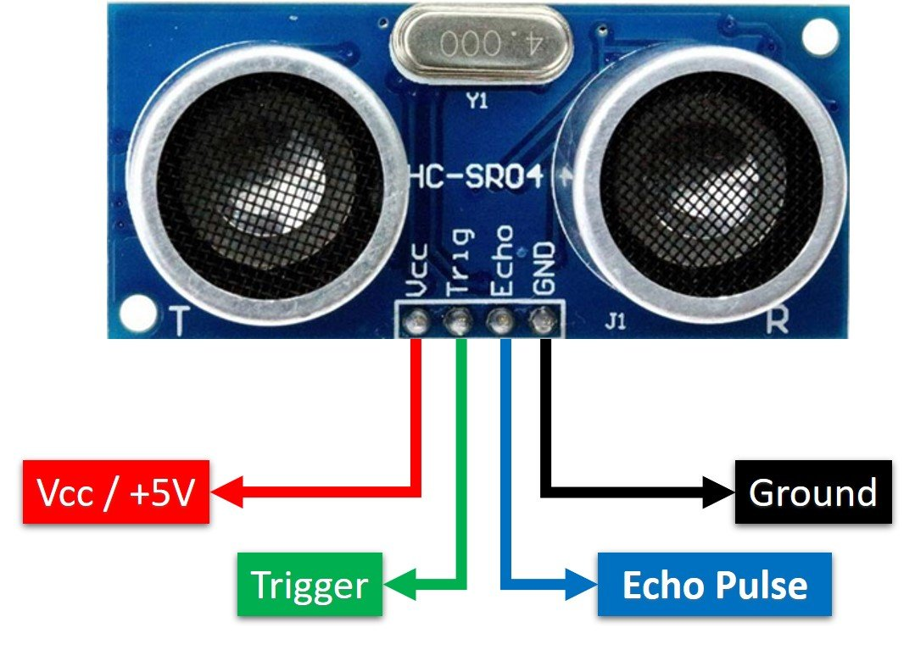
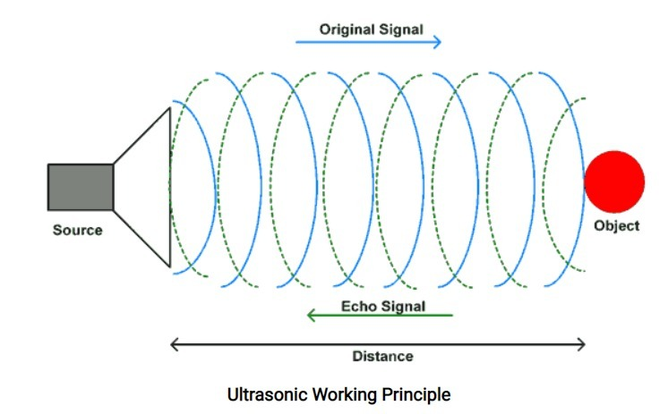
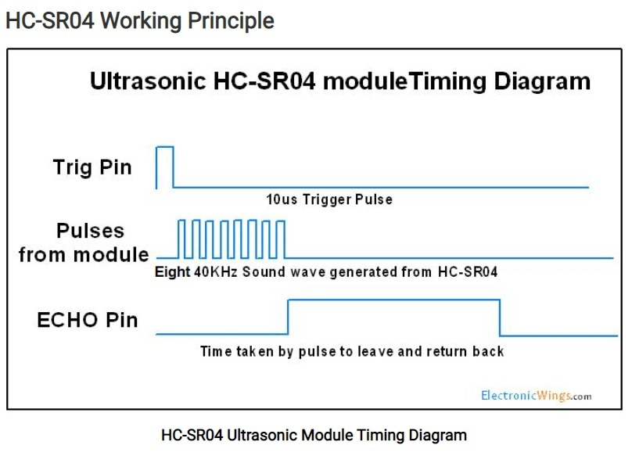
Test and implementation
Member 1 : Nusky M.N.N.(204146L)
Individual contribution
Designing and programming the Digital display and Ultrasonic sensor modules.
Responsibilities
To study the basic microcontroller concepts.
To study the simulation software and programming software.
To design and program Digital display and Ultrasonic sensor modules.
Ultrasonic Sensor
Maximum Voltage – 5V
Maximum Current – 20mA

Slide 14
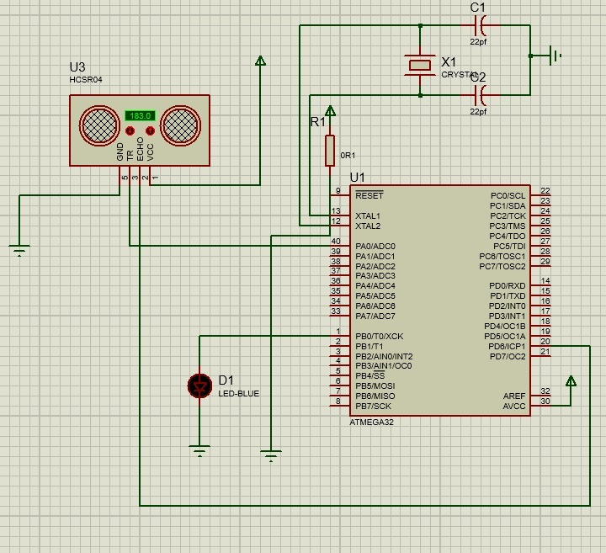
Circuit Diagram
Figure 6 -Ultrasonic sensor circuit diagram

Slide 15
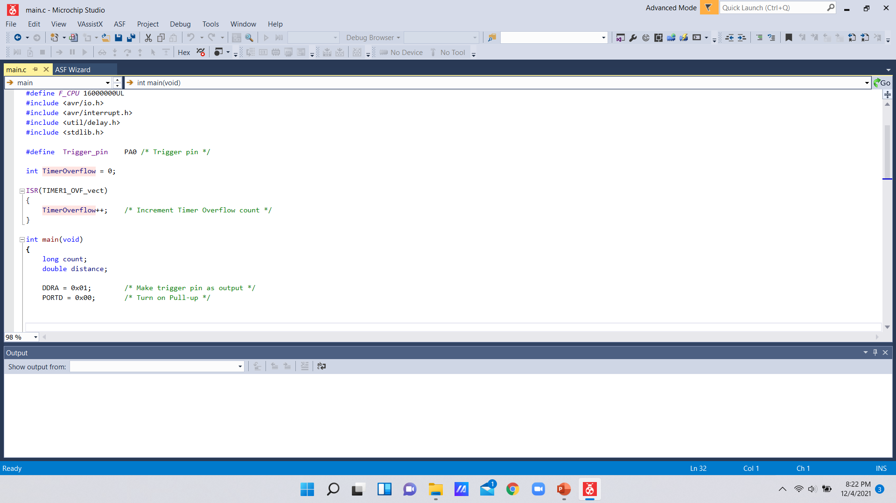
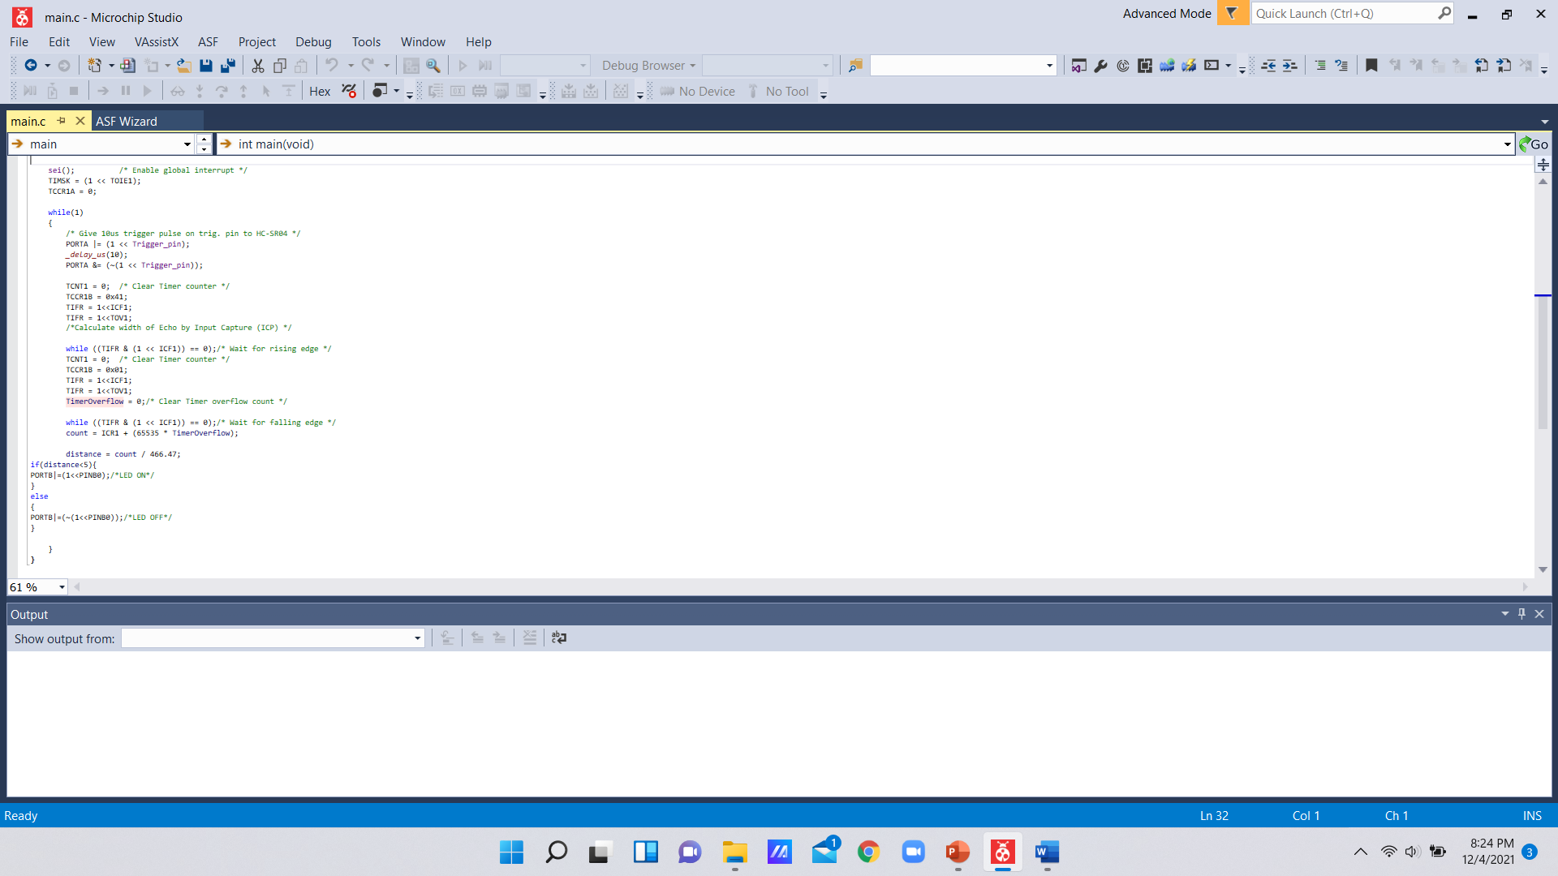
Compiled Code
Figure 7 -Ultrasonic sensor C code

Slide 16
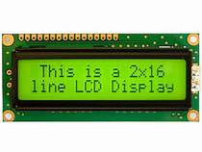
Test and implementation
Digital Display
Maximum Voltage – 5V
Maximum Current – 5mA
Links to speciation Data Sheets :
https://www.vishay.com/docs/37299/37299.pdf
http://www.pantron.com/us/datasheets/contrinex-ultrasonic-sensors.pdf

Slide 17
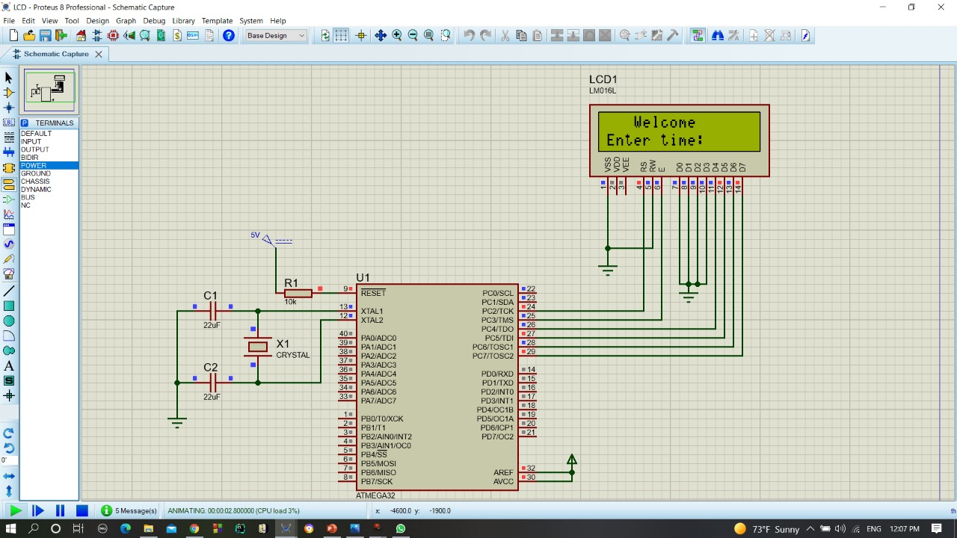
Circuit Diagram
Figure 8 –Digital display circuit diagram

Slide 18
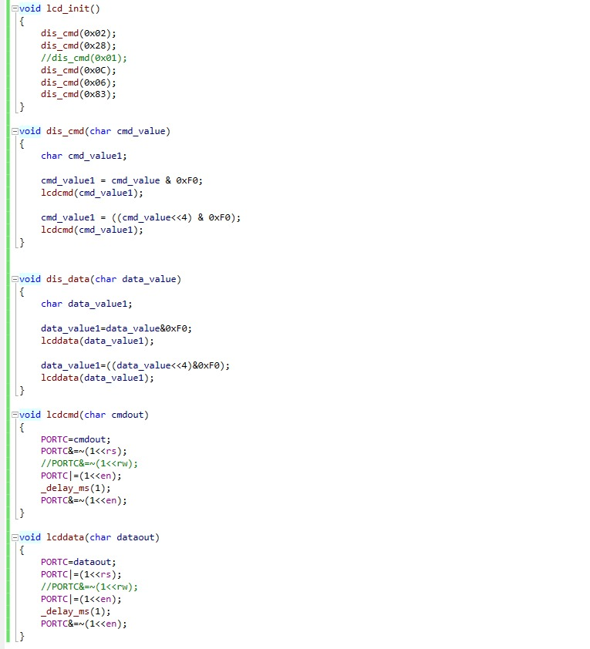
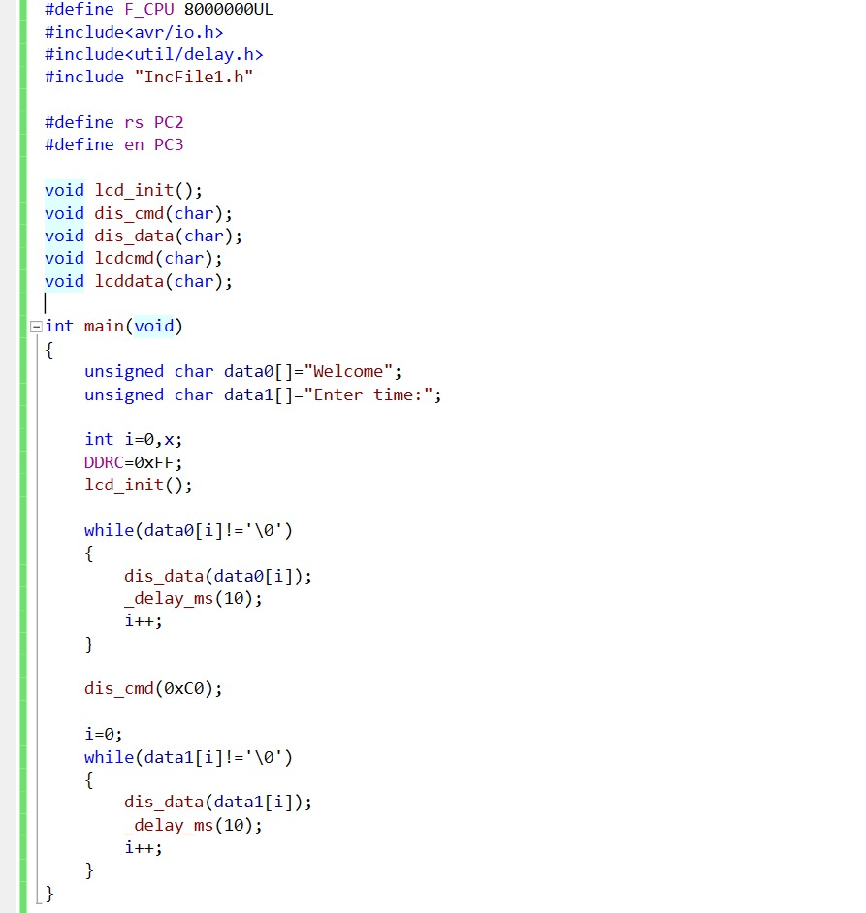
Compiled code
Figure 9 –Digital display c code

Slide 19
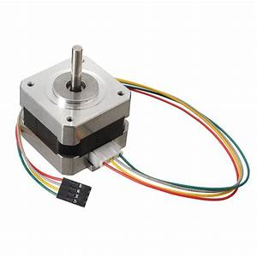
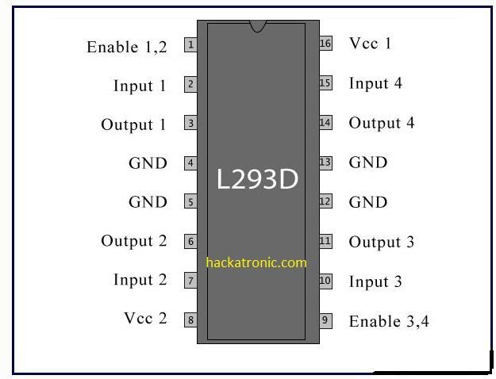
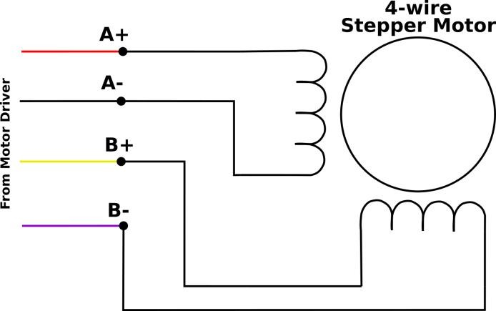
Test and implementation
Member 2 : Banu A.G.S.(204018X)
Individual contribution
Designing and programming the Stepper motor module and power supply.
Responsibilities
To study the basic microcontroller concepts.
To study the simulation software and programming software.
To design and program stepper motor module and power supply.
Maximum Voltage - 12V
Maximum Current - 1.68A
Link to speciation Data Sheet :
https://datasheetspdf.com/pdf-file/1260602/Schneider/NEMA17/1

Slide 20
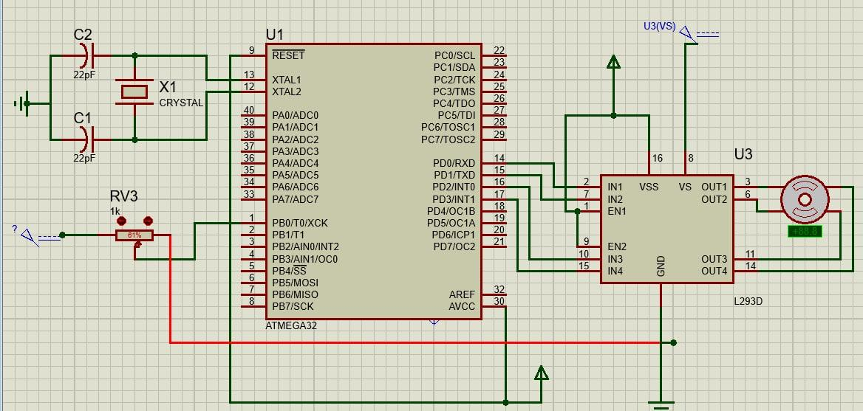
Circuit Diagram
Figure 10-Stepper motor circuit diagram

Slide 21
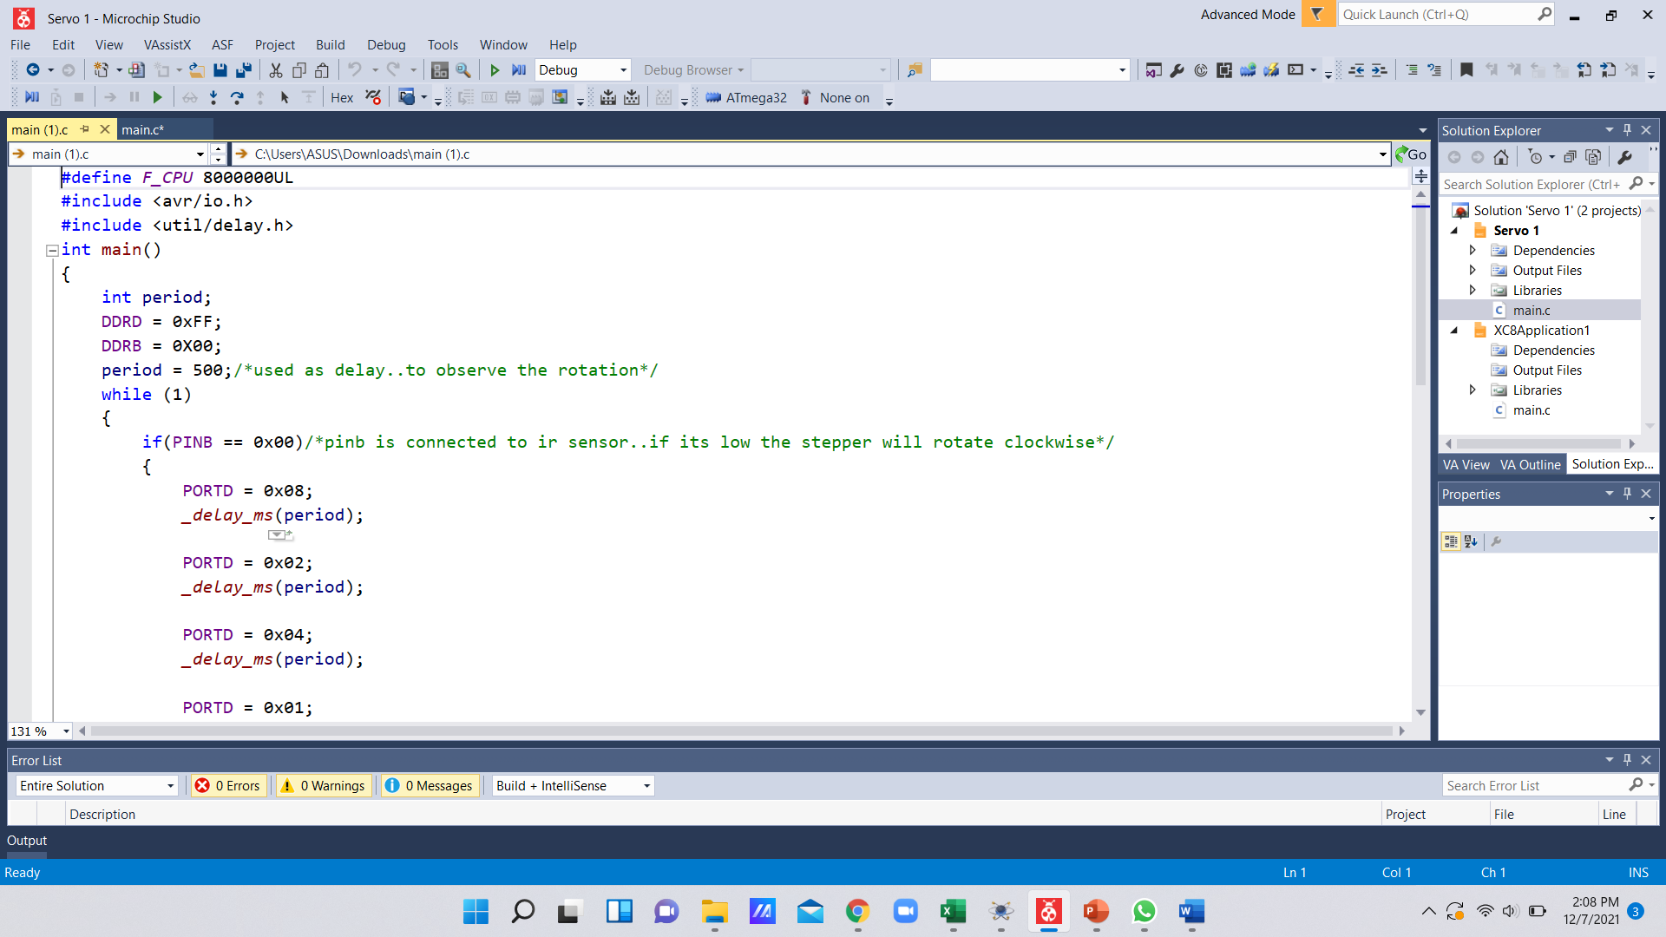
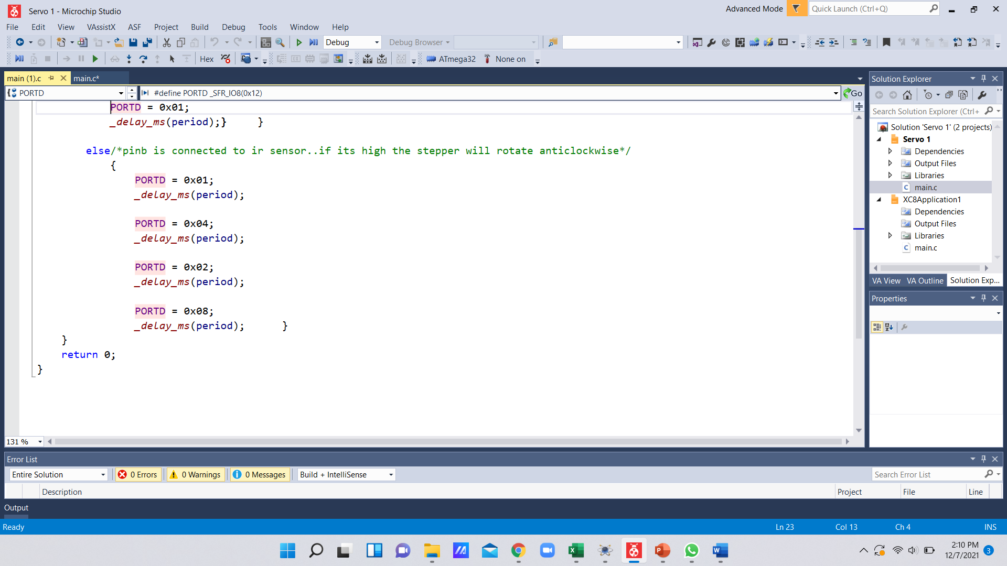
Compiled code
Figure 11 - Stepper motor C code

Slide 22
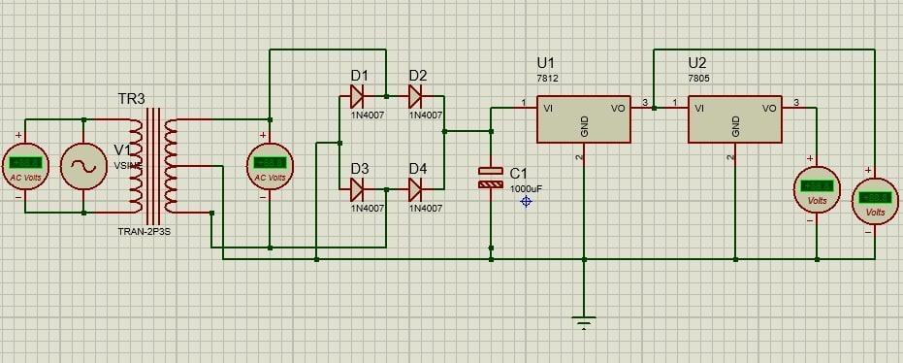
Circuit Diagram
Figure 12 -Power supply

Slide 23

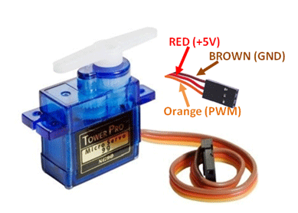
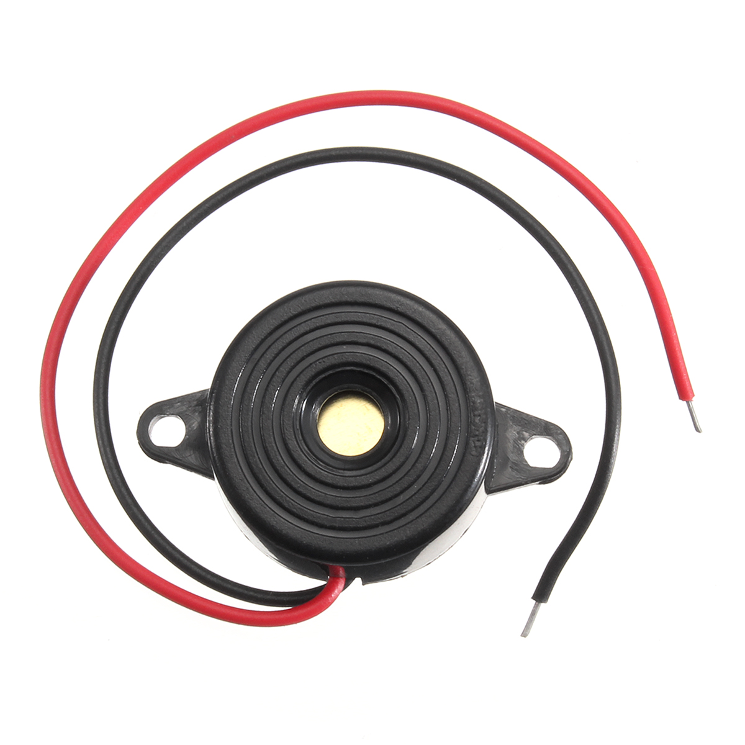
Test and implementation
Member 3 : Karunaweera R.L.(204096G)
Individual contribution
Designing and programming the servo motor and buzzer modules.
Responsibilities
To study the basic microcontroller concepts.
To study the simulation software and programming software.
To design and program servo motor and buzzer modules.
Links to speciation Data Sheets :
https://components101.com/motors/servo-motor-basics-pinout-datasheet
https://docs.rs-online.com/3432/A700000007927576.pdf
 | Maximum Voltage | Maximum Current
Servo motor | 6V | 1A
Buzzer | 20V | 10mA

Slide 24
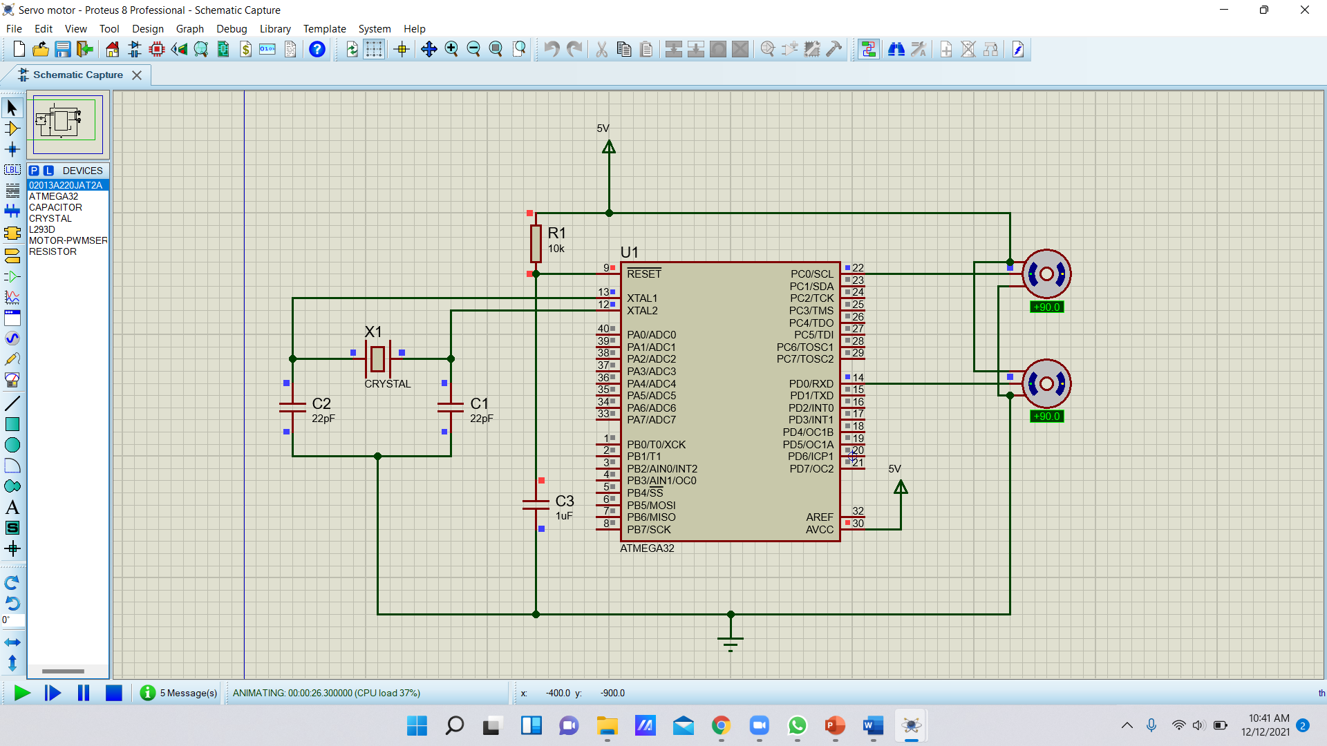
Circuit Diagram
Figure 13- Servo motor circuit diagram

Slide 25
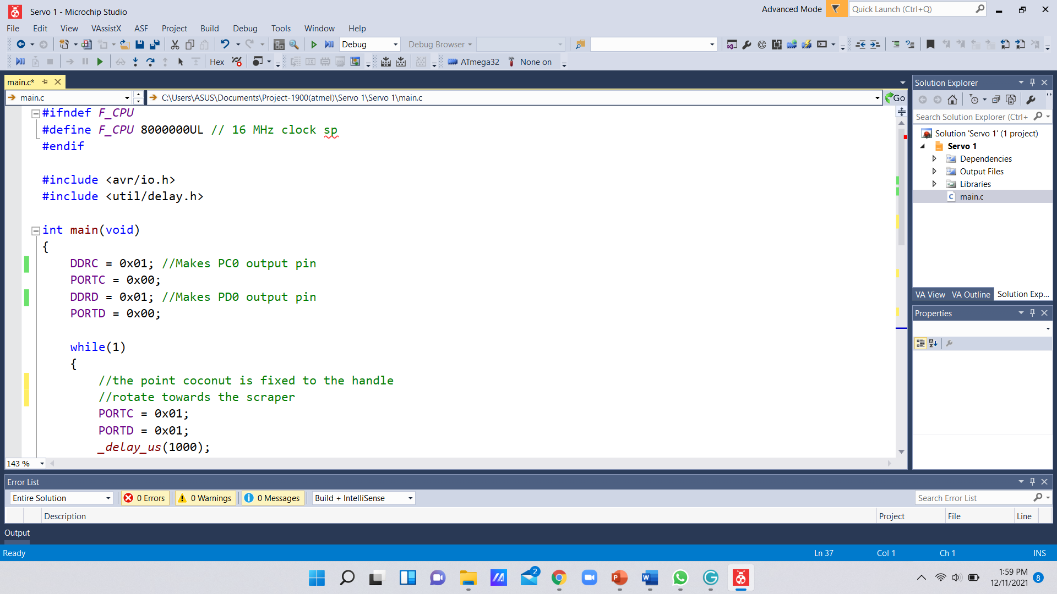
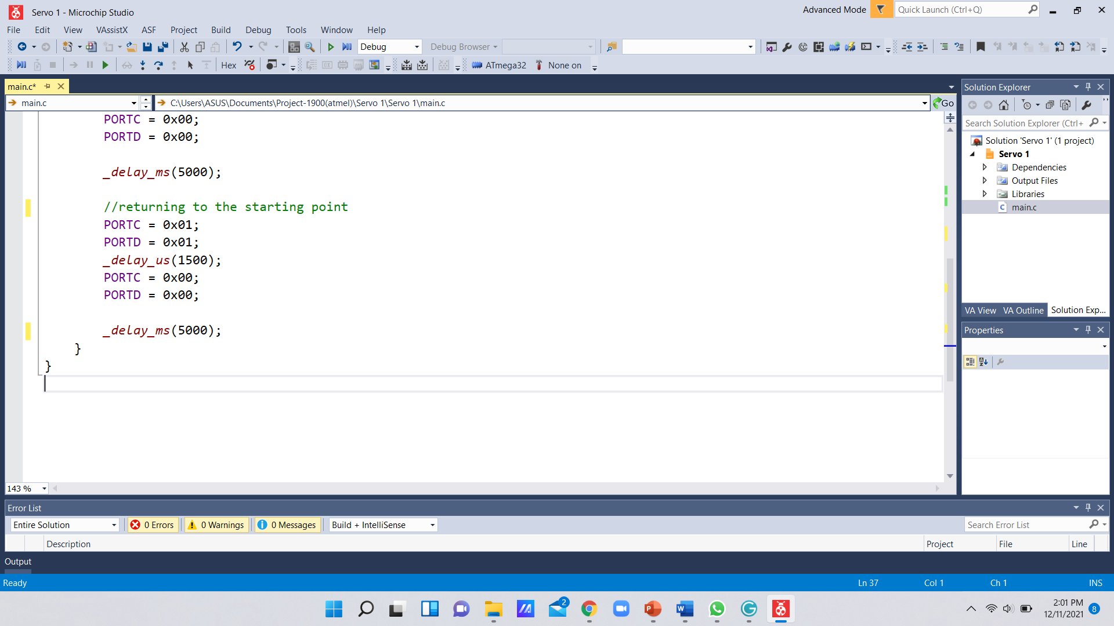
Compiled code
Figure 14-Servo motor C code

Slide 26
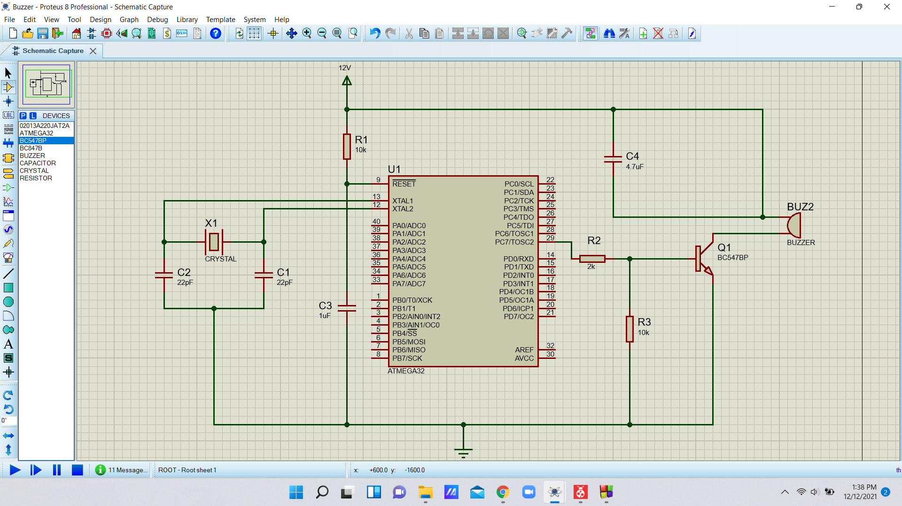
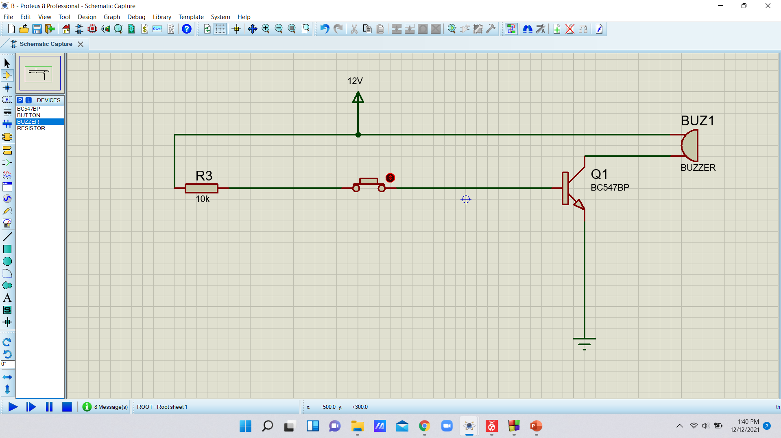
Circuit Diagram
Figure 15- Buzzer circuit diagram

Slide 27
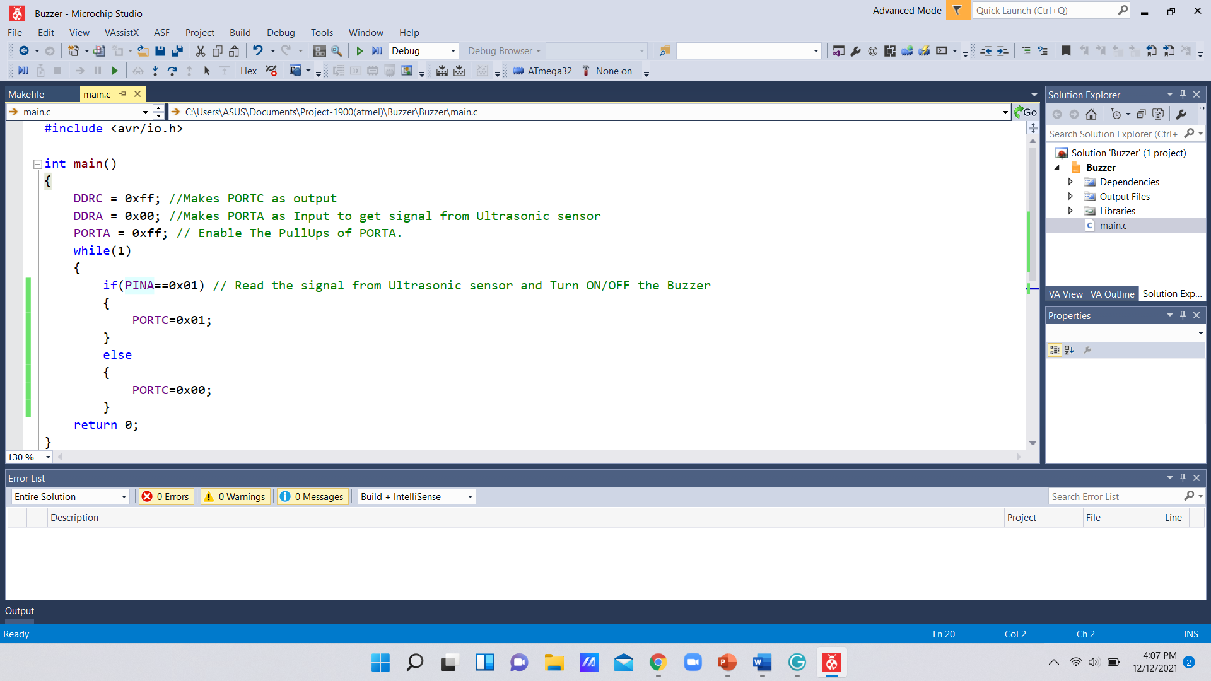
Compiled code
Figure 16- Buzzer C code

Slide 28
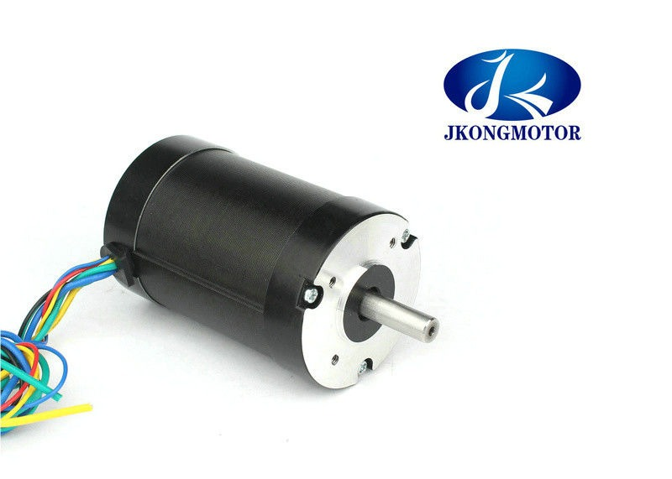
Test and implementation
Member 4 : Kumarasingha H.J.A.(204108A)
Individual contribution
Designing and programming the DC motor module.
Responsibilities
To study the basic microcontroller concepts.
To study the simulation software and programming software.
To design and program DC motor module.
Maximum Voltage - 12V
Maximum Current - 0.64A
Link to speciation Data Sheet :
https://www.contact-evolution.ch/files/DC_motors.pdf

Slide 29
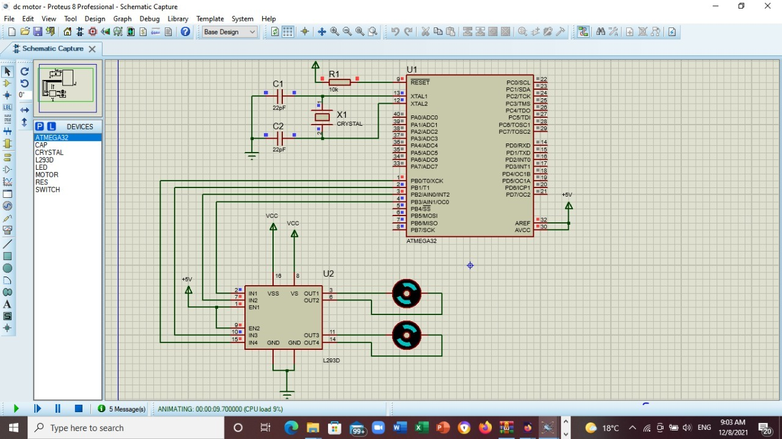
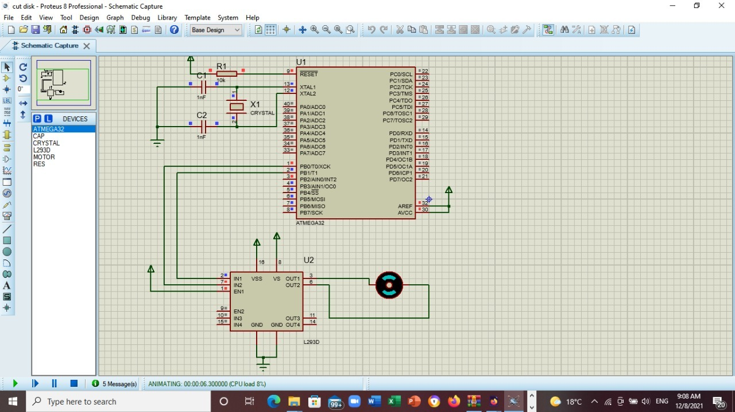
Circuit Diagram
Figure 17 -DC motor circuit diagram

Slide 30
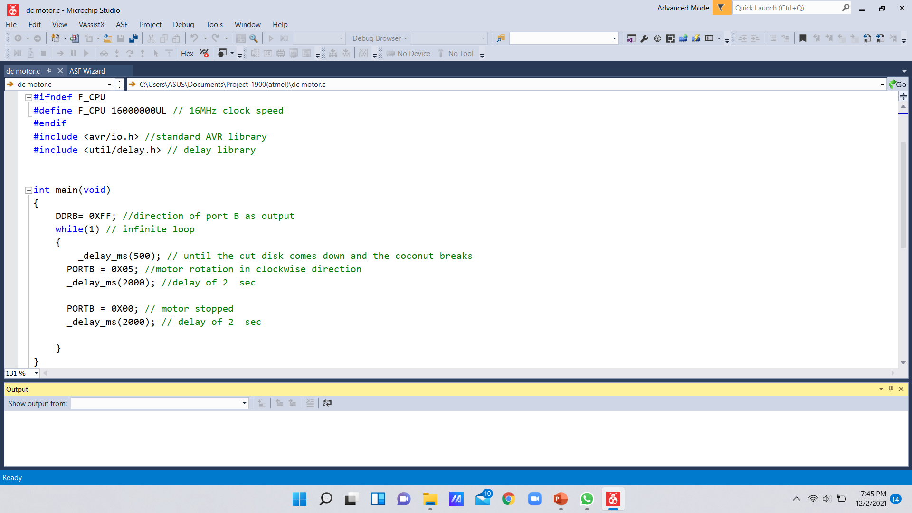
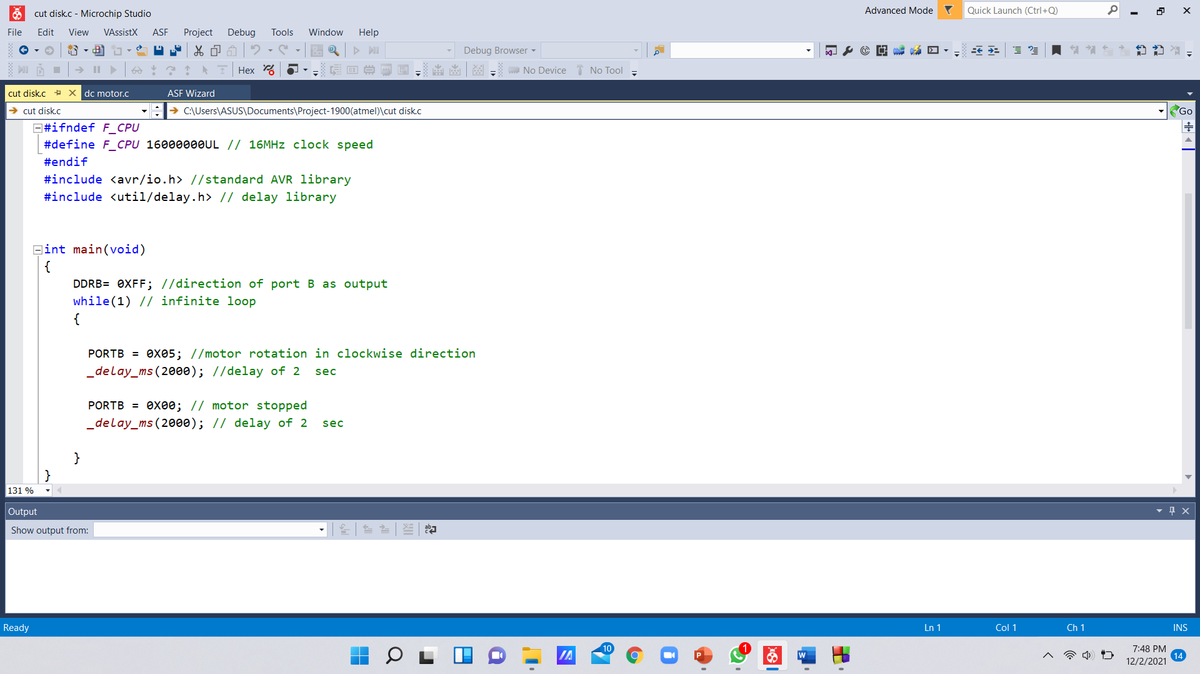
Compiled code
Figure 18 - DC motor C code

Slide 31
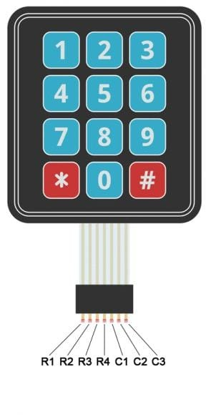
Test and implementation
Member 5: Lamahewage D.R.(204114M)
Individual contribution
Designing and programming the Keypad and IR sensor modules.
Responsibilities
To study the basic microcontroller concepts.
To study the simulation software and programming software.
To design and program Keypad and IR sensor modules.
Digital Display
Maximum Voltage – 24V
Maximum Current – 20mA
Link to speciation Data Sheet :
https://components101.com/sites/default/files/component_datasheet/4x4%20Keypad%20Module%20Datasheet.pdf

Slide 32
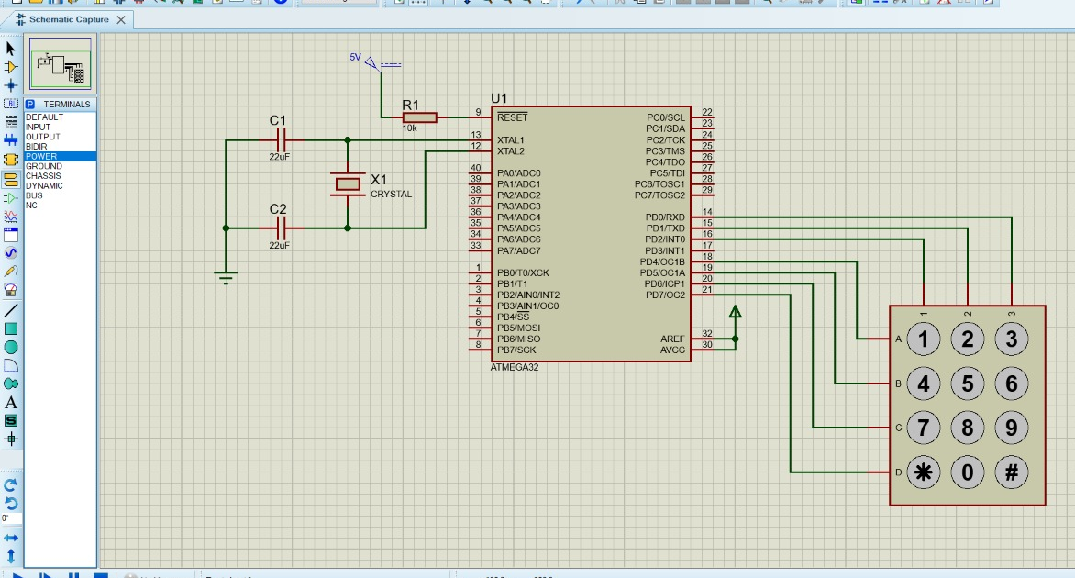
Circuit Diagram
Figure 19- Display & Keypad circuit diagram

Slide 33
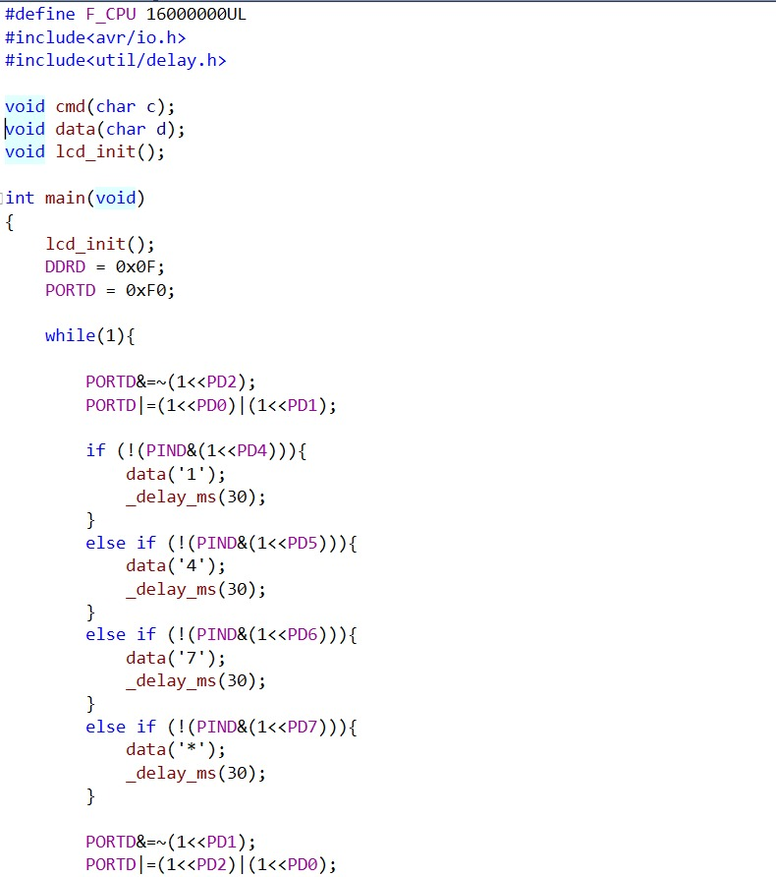
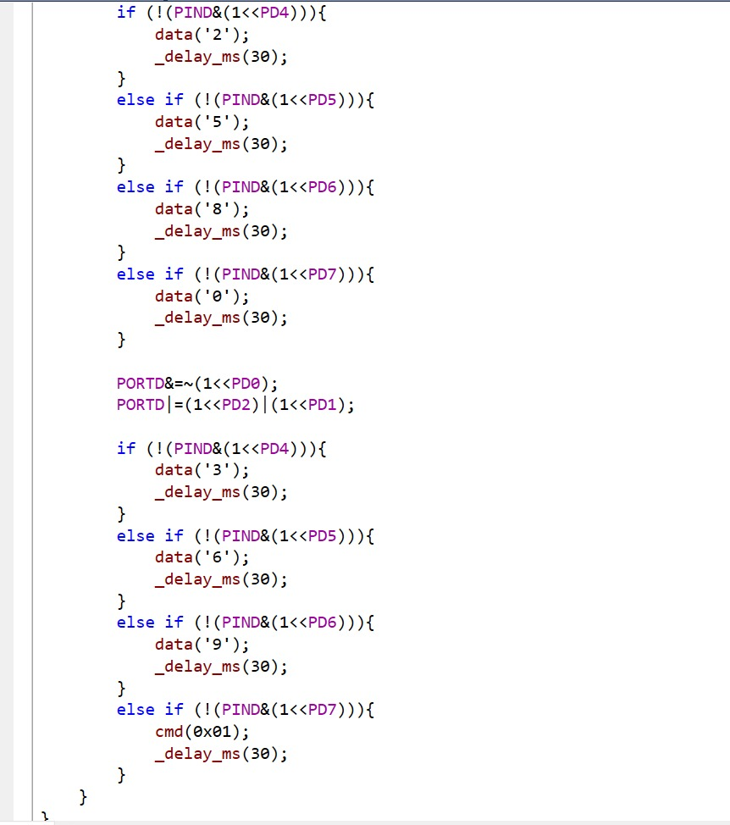
Compiled code
Figure 20- Display & Keypad C code

Slide 34
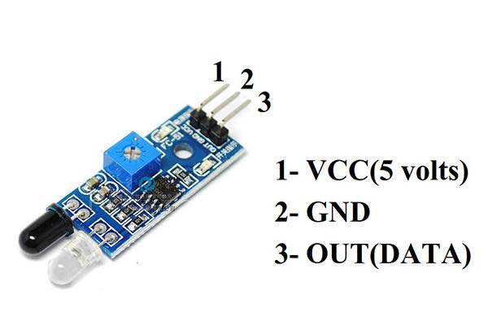
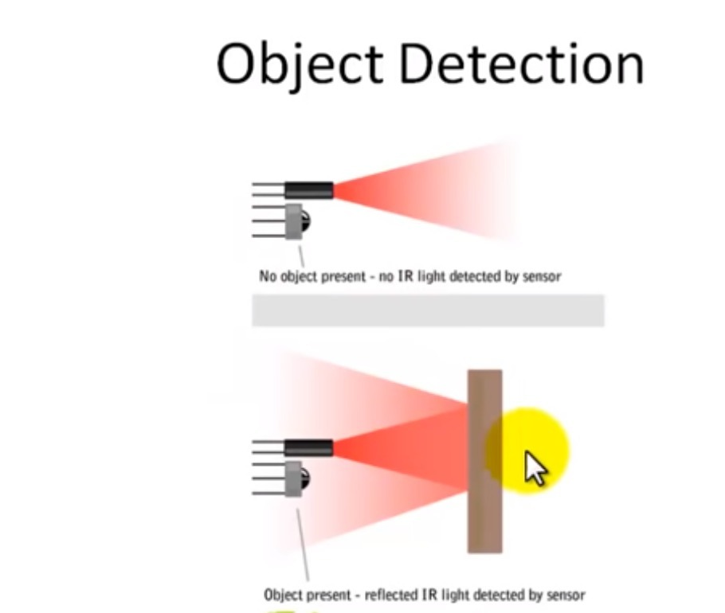
Test and implementation
IR Sensor
Maximum Voltage - 5V
Maximum Current – 20mA
Link to speciation Data Sheet :
https://datasheetspdf.com/pdf/1380138/ETC1/HC-SR04/1
https://components101.com/sensors/ir-sensor-module

Slide 35
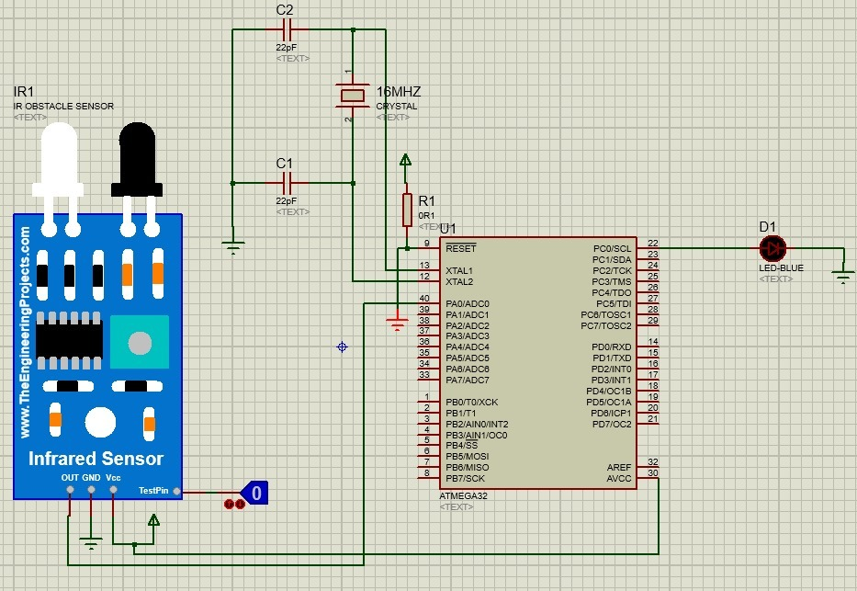
Circuit Diagram
Figure 21 -IR sensor circuit diagram

Slide 36

Compiled Code
Figure 22 - IR sensor C code

Slide 37
References
ADMIN, "atmega32avr," atmega32avr, 2015. [Online]. Available: https://atmega32-avr.com/speed-direction-control-stepper-motor-using-avr-microcontroller/amp/. [Accessed 15 September 2021].
B. Ayob, "Atmega32-avr," [Online]. Available: https://atmega32-avr.com/servo-motor-control-using-avr-atmega32-microcontroller/.
B. Ayob, "atmega32-avr," atmega32-avr, 25 April 2012. [Online]. Available: https://atmega32-avr.com/atmega-32-pinout/. [Accessed 29 September 2021].
B. Earl, "ADAFRUIT," ADAFRUIT, 5 May 2014. [Online]. Available: https://learn.adafruit.com/all-about-stepper-motors. [Accessed 15 October 2021].
E. Funda, "Engineering Funda," Engineering Funda, 24 May 2021. [Online]. Available: https://www.youtube.com/watch?v=awS93t-uX4Q. [Accessed 29 October 2021].
Github, "Embedotronics," Embedotronics, 2021. [Online]. Available: https://github.com/Embedotronics/Atmega16-interfacing-with-LCD-in-4-bit-mode. [Accessed 26 October 2021].
. chandak, "ElectronicWings Homepage," ElectronicWings , 2018. [Online]. Available: https://www.electronicwings.com/avr-atmega/ultrasonic-module-hc-sr04-interfacing-with-atmega1632. [Accessed 23 October 2021].
l. chandak, "ElectronicWings Homepage," ElectronicWings Homepage, 2018. [Online]. Available: https://www.electronicwings.com/avr-atmega/interfacing-lcd-16x2-in-4-bit-mode-with-atmega-16-32-. [Accessed 16 September 2021].
TUSHAR, "Embedds," Embedds, 2018. [Online]. Available: https://embedds.com/interfacing-dc-motor-to-atmega32/. [Accessed 25 September 2021].
Unknown, "Wikipedia," Wikipedia, 21 August 2021. [Online]. Available: https://en.wikipedia.org/wiki/DC_motor. [Accessed 15 October 2021].

Slide 38

Thank you!
Questions?

